Slide 1


Sky Talk
“Better, Faster, Cheaper”
Or why good testing: is good security; is good software
Anthony McKale
Principal Software Engineer
06/04/2022

Slide 2
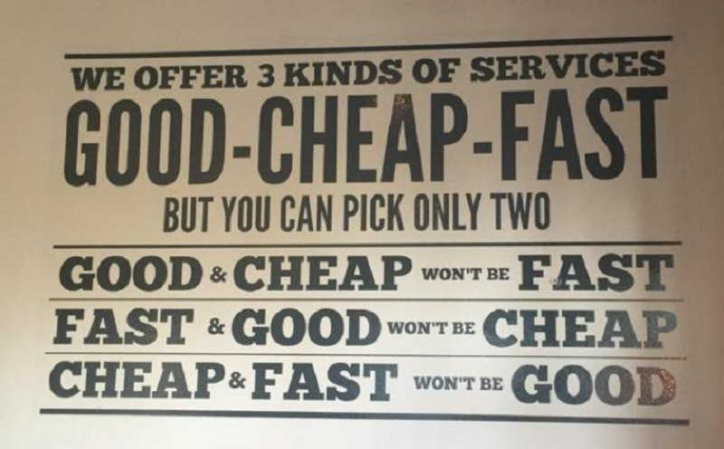
Topics
* We only built good things, so it’s expensive or slow

Slide 3
Topics

Slide 4
Topics
Talk Questions:
What testing makes code more reliable ? (aka better)
What testing makes code more secure ? (aka better)

Slide 5
Agenda
- why testing good (10 mins) HOMOUR WARNING
- Why SCA testing good (10 mins)
- Questions ?

Slide 6
HOMOUR WARNING
Testing is important .
Not testing is bad for you, and bad for your projects

Slide 7
HOMOUR WARNING
Good Testing is Good Security
.
More Bugs ===
More Security Flaws

Slide 8
HOMOUR WARNING
This talk is advocating
more automated testing

Slide 9
Agenda: why testing good
10 short minutes to explain why testing pipelines are only needed by muggles and NASA
* Aimed at developers, apologises for unexplained confusing terms

Slide 10
Agenda : is testing pointless ?
Known Developer facts:
LINTING : All code is excellent
UNIT TESTING: Developers never write bugs
INTER. TESTING: Software always works together
SCA TESTING: Applications do not grow old

Slide 11
Linting: All code is excellent
we can agree, developers:
create good clean code
understand their languages perfectly
… Javascript is a easy

Slide 12
Linting: All code is excellent
Linting* is hence pointless
* linter: a tool designed to hurt your feelings, when code is executing fine
but malformed

Slide 13
Linting: All code is excellent
“Audience Participation” : Javascript is easy
“which lines return true ?”

Slide 14
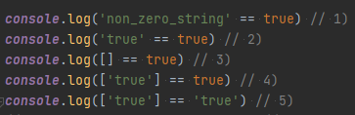
Linting: All code is excellent
“which lines return true ?”

Slide 15
Linting: All code is excellent
“which lines return true ?”

Slide 16
Linting: All code is excellent
“which lines return true ?”

Slide 17
Linting: All code is excellent
“which lines return true ?”

Slide 18
Linting: All code is excellent
“which lines return true ?”

Slide 19
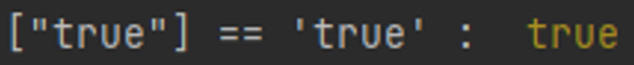
Linting: All code is excellent
“which lines return true ?”
Obviously, the winner is :

Slide 20
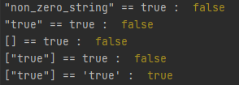
Linting: All code is excellent
WAT…

Slide 21
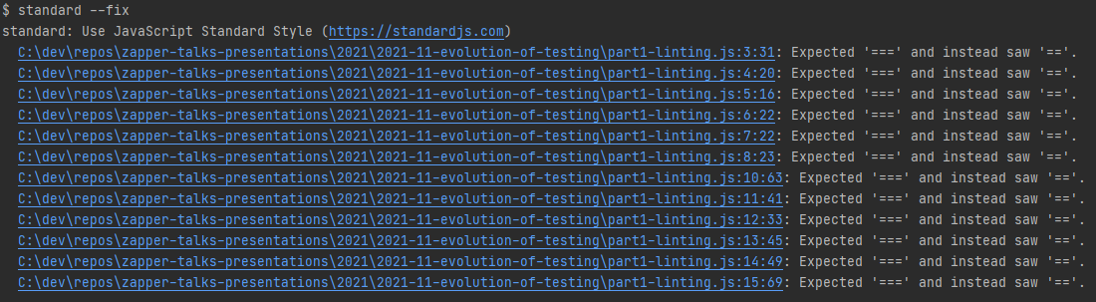
Linting: All code is excellent
Maybe making code boring* with linting isn’t such a bad idea
* Boring = Easy to read / Predicable

Slide 22
Linted code looks excellent
So “Linting” is ok

Slide 23
Unit Testing: Devs never write bugs
we can agree, developers:
never write bugs
understand their code
… Javascript can count

Slide 24
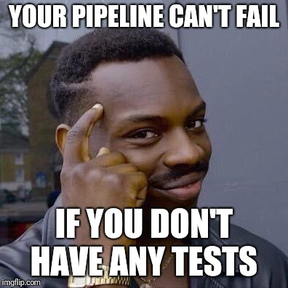
Unit Testing: Devs never write bugs
hence Unit Testing is pointless
https://www.reddit.com/r/ProgrammerHumor/comments/8fbgcp/unit_tests_ha/

Slide 25
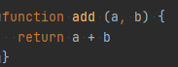
Unit Testing: Devs never write bugs
You do NOT ever need to test this code
This works for ALL inputs, ALL the time

Slide 26
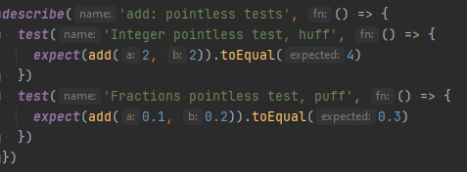
Unit Testing: Devs never write bugs
Unit Testing that this code is perfect .
(2 + 2 = 4) and (0.1 + 0.2 = 0.3)

Slide 27
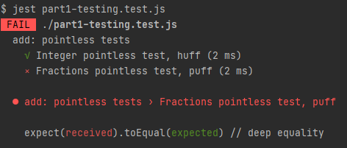
Unit Testing: Devs never write bugs
WAT…

Slide 28
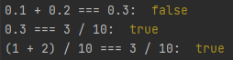
Unit Testing: Devs never write bugs
so … Javascript isn’t good at counting decimal fractions
Details for the interested :

Slide 29
Tested code has less bugs
So “Unit Tests” are good

Slide 30
Testing: Code always works together
we can agree, software has:
Good input sanitisation
Common i/o metric units
Same time zones
Only idiots would spend years building systems that didn’t work together…

Slide 31
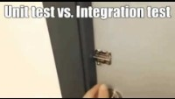
Testing: Code always works together
hence Integration Testing is pointless
https://www.youtube.com/watch?v=0GypdsJulKE

Slide 32
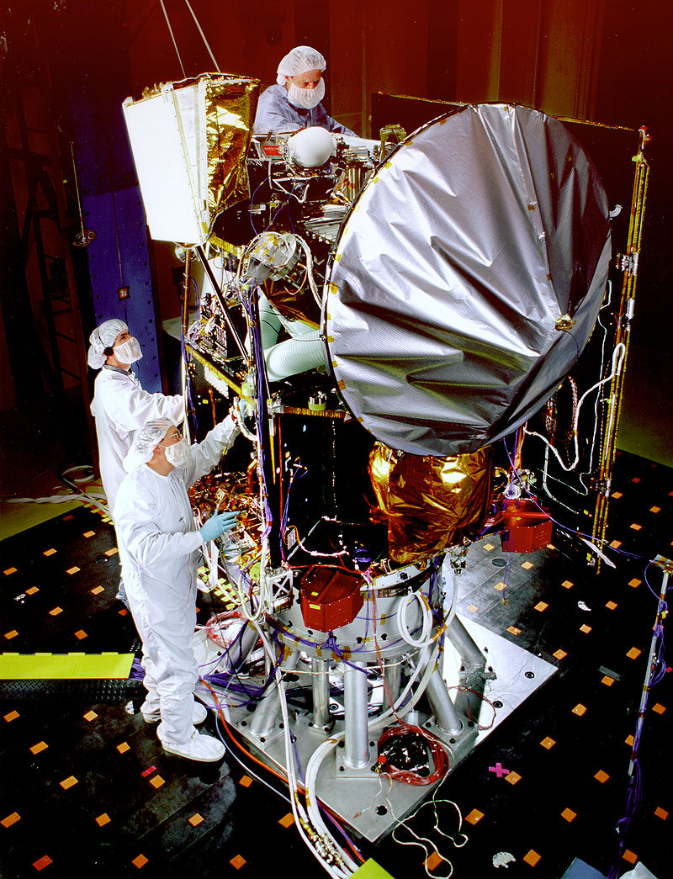
Testing: Code always works together
NASA’s Mars Climate Orbiter ’98

Slide 33
Testing: Code always works together
NASA’s Mars Climate Orbiter ‘98
System A (Onboard ECU):
Asked for newtons per sq meter
for thrusters

Slide 34
Testing: Code always works together
NASA’s Mars Climate Orbiter ’98
System B (Ground Control Computer):
Gave pounds per sq meter for thrusters

Slide 35
Testing: Code always works together
NASA’s Mars Climate Orbiter ’98
What happened next ?
System A:
Input is in newtons per sq meter
System B:
Output is in pounds per sq meter

Slide 36

Testing: Code always works together
A $327 million Rocket blewup
So… NASA blow up the odd spaceship
Maybe integration testing could of helped
https://en.wikipedia.org/wiki/Mars_Climate_Orbiter

Slide 37
Testing: Software needs field testing
So maybe “Integration Tests” are useful

Slide 38
Applications never grow old
I think we can agree, all software:
does not age
semver* updates carry no risk
dependencies are safe forever
… Javascript is secure
* Semantic Versioned

Slide 39
Applications never grow old
SCA (Software Component Analysis)* is hence pointless
* Github adv. security (many) / eze (many) / npm_audit (node) / dependency_check (java) / safety (python) ….

Slide 40
Applications never grow old: 1
Software doesn’t age, once deployed you never have new issues

Slide 41
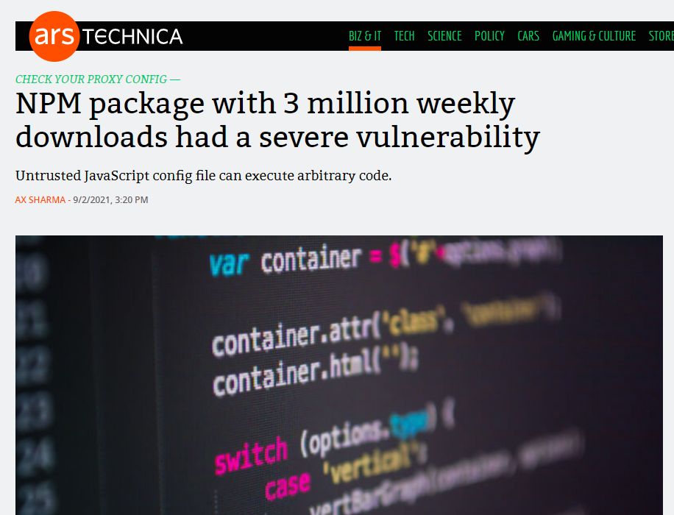
Applications never grow old: 1
Software doesn’t age, once deployed you never have new issues … never

Slide 42
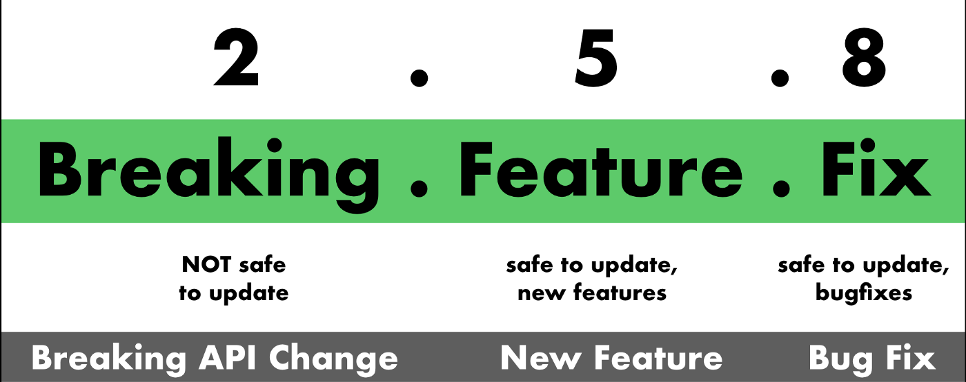
Applications never grow old: 2
* Semantic Versioning Primer
.
Given a version number MAJOR.MINOR.PATCH
https://blog.greenkeeper.io/introduction-to-semver-d272990c44f2

Slide 43
Applications never grow old: 2
Semantic versioning makes updating dependencies risk free

Slide 44
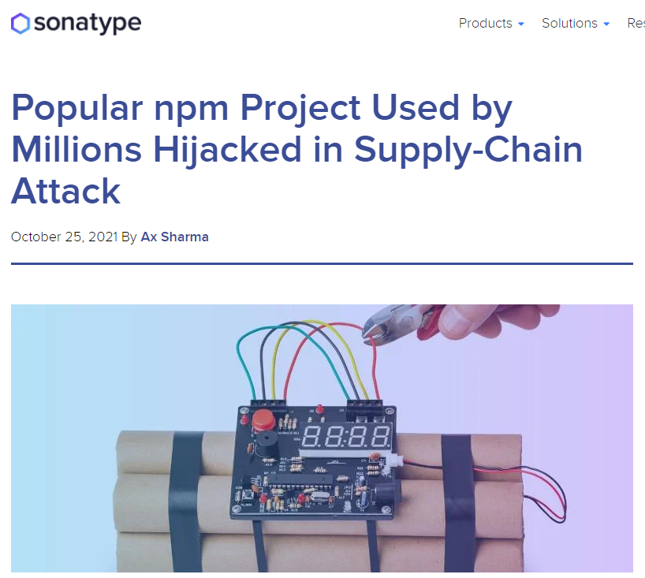
Applications never grow old: 2
Semantic versioning makes updating dependencies risk free
Supply-chain attacks take over repos, and upload compromised trivial versions

Slide 45
Applications never grow old: 2
Supply-chain attacks
Remember:
Library can attack the user (run time)
Library can attack the CI (install / build time)
[npm] dependencies trees run deep

Slide 46
Applications never grow old
dependencies are safe forever

Slide 47
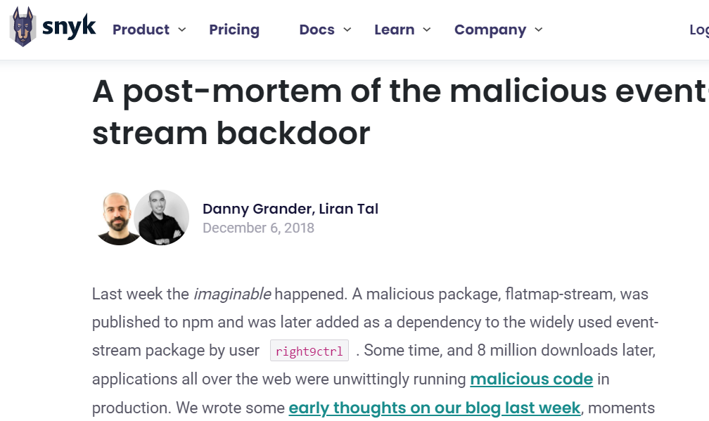
Applications never grow old
dependencies are safe forever
but they have non-safe sub-dependencies
https://snyk.io/blog/a-post-mortem-of-the-malicious-event-stream-backdoor/

Slide 48
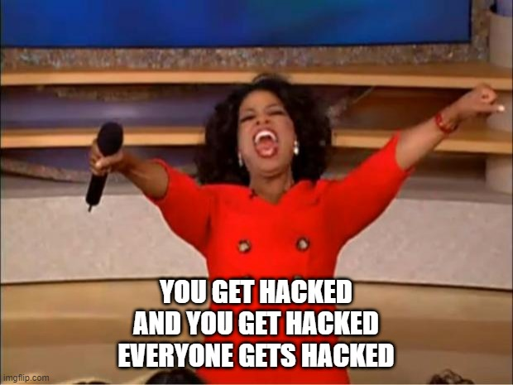
Applications never grow old
dependencies are safe forever
but they have non-safe sub-dependencies
https://imgflip.com/i/5v8jfw

Slide 49
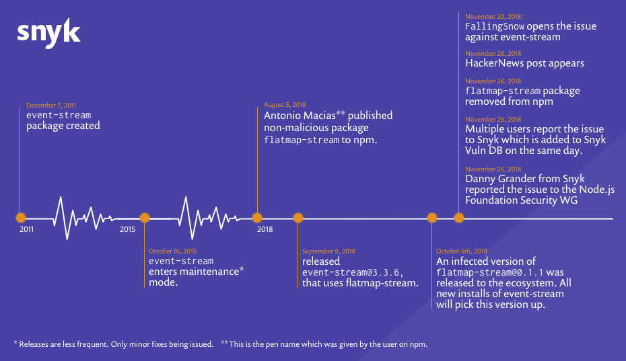
Applications never grow old
46 days of Event Stream exploitation
https://snyk.io/blog/a-post-mortem-of-the-malicious-event-stream-backdoor/

Slide 50
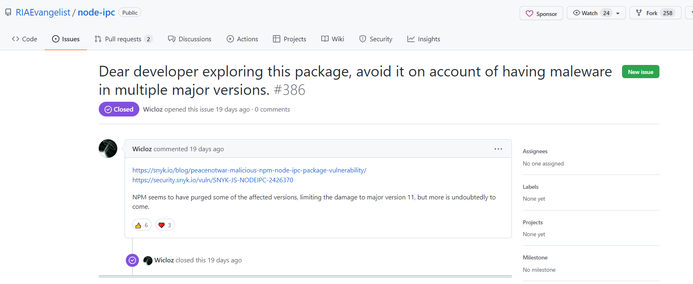
Applications: Protestware…
Hot off the press, is opensource safe anymore ?
https://www.technologyreview.com/2022/03/21/1047489/activists-are-targeting-russians-with-open-source-protestware/

Slide 51
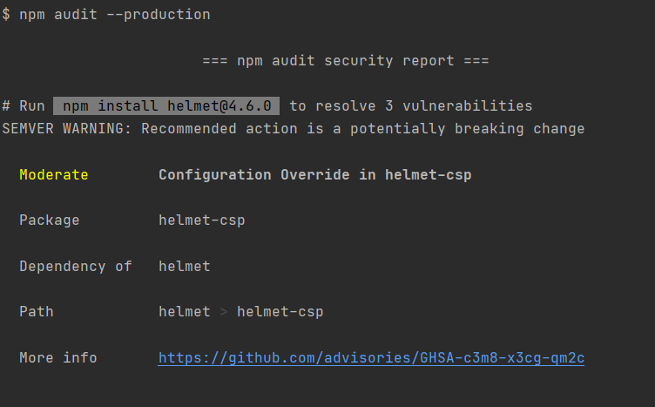
All Applications get old
Maybe… run SCA tools regularly to catch new vulnerable dependencies
Just for the muggles obviously

Slide 52
Questions: is testing good ?
So, I think we can agree
“Lint”, “Unit Tests”, “Integration Tests”, “SCA Tools” are good for test pipelines
Deep down we’re all muggles
(even if you work for NASA)

Slide 53
So testing is good ok ?
Now lets chat security testing
Problems
Solutions

Slide 54
Modern Security Problems

Slide 55
Modern Security Problems
- 1) Dependencies
- 2) User Code
- 3) Infrastructure (outside of scope)

Slide 56
Modern Security Problems
- 1) Dependencies
- 2) User Code
- 3) Infrastructure

Slide 57

Dependencies
Modern software is built on top of external libraries
Each external library is built on top of others, like the layers of a onion
External libraries tend to be opensource, community created, and the eco systems and licensing are mature
Perfect, right?
What could go wrong ?

Slide 58
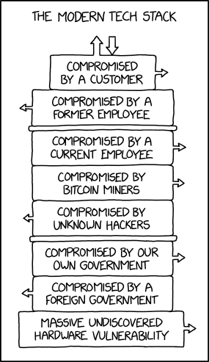
Dependencies
* Stack https://xkcd.com/2166/

Slide 59
Dependency Issue Overview
Common library issues*
Lack of software inventory
Dependency Licensing
Dependency flaws
Dependency supply chain attacks
* Non exhaustive list

Slide 60
Dependency Issue Overview
Common library issues*
Lack of software inventory
Dependency Licensing
Dependency flaws
Dependency supply chain attacks
* Non exhaustive list

Slide 61
Dependencies Inventory / Audit
Lack of inventory of libraries contained in software project
This is known as a SBOM (“Software Bill of Materials”*)
Standard Language tooling doesn’t generate an SBOM, this task often isn’t done, leaving the software owner not knowing the contents of their code
External tools/step are required to generate these
As such,
* https://en.wikipedia.org/wiki/Software_bill_of_materials

Slide 62
Dependency Issue Overview
Common library issues*
Lack of software inventory
Dependency Licensing
Dependency flaws
Dependency supply chain attacks
* Non exhaustive list

Slide 63
Dependencies License poisoning
Licenses of software libraries are not all the same or equal
One particular license risk for commercial software is GPL poisoning
GPL is strong copy left*, this type of license recursively propagates up, aka all software including GPL libraries are automatically GPL licensed
Legally the source code would need to be exposed publicly, and any software patents involved might be at risk, and anyone could sell/copy your code
* Different from weak copy left which is not typically a concern (LGPL)

Slide 64
Dependencies Licensing conditions
Licenses of software libraries even if they are not GPL or other type of strong copy left license often have licensing conditions
These could be :
- Restrictions usage by industry type
Public attribution on adverting
Attribution inside code
Failure to complete this conditions could result in fines, or action by public free software law organisations

Slide 65
Dependency Issue Overview
Common library issues*
Lack of software inventory
Dependency Licensing
Dependency flaws
Dependency supply chain attacks
* Non exhaustive list

Slide 66
Dependencies Software Flaws
Public libraries security faults are public disclosure via the CVE* system
CVE good and bad:
All organisations and engineers can report flaws for the public good
Engineers can easily find and update/or remove insecure libraries
Hackers can easily find flaws in unpatched systems
* https://en.wikipedia.org/wiki/Common_Vulnerabilities_and_Exposures

Slide 67
Dependencies Software Flaws Gotcha
Language compilation tooling doesn’t* perform a security audit of components
External tooling is required to run these security audits
* Node / NPM is a excellent exception of one that does

Slide 68

Dependencies Software Flaws Example Log4J
Widely used library for commercial java software
Zero day* Critical flaw* was found in October 2021 that allowed arbitrary execution
All unpatched software can be remotely hacked
https://en.wikipedia.org/wiki/Zero-day_(computing)
https://nvd.nist.gov/vuln/detail/CVE-2021-44832

Slide 69
Dependencies Software Flaws Example Node
Widely used library for commercial node software for handling corporate internet proxies

Slide 70
Dependency Issue Overview
Common library issues*
Lack of software inventory
Dependency Licensing
Dependency flaws
Dependency supply chain attacks
* Non exhaustive list

Slide 71
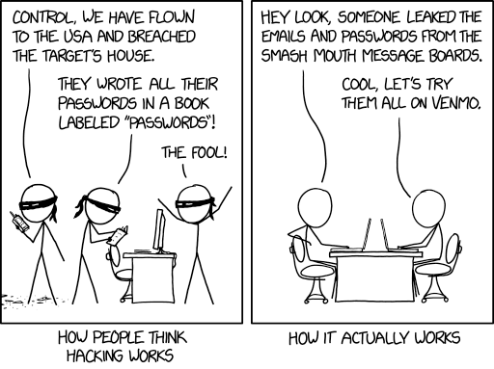
Dependencies Supply chain attacks
* How hacking works https://xkcd.com/2176/

Slide 72
Dependencies Supply chain attacks
Many Opensource libraries are created by small teams of volunteers
These volunteers can be targeted by attackers gaining access to their software projects, and in turn gaining access to all down stream projects including that software
Common attacks
Social Engineering
Hacking personal accounts
Bribery
Vandalism* where the creators intentionally corrupt their own work

Slide 73
Dependencies Supply chain attacks Consequences
hijacked dependency consequences are severe
Library scripts will be run at build time in CI servers, compromising any secrets that CI has exposed
Libraries will be compiled into the resulting applications, so users will be compromised as well
And of course, follow on attacks are possible using stolen credentials

Slide 74
Dependencies Software Flaws Example Node
Widely used library for all node software for handling networking “Event Stream” Hijacked via social engineering, was updated to steal crypto currency
Millions of projects ran corrupted code
https://snyk.io/blog/a-post-mortem-of-the-malicious-event-stream-backdoor/

Slide 75
Dependencies Recent Supply chain attacks
Recent Software Supply Chain Attacks
Excellent more detailed timeline of recent issues from sonatype
https://www.sonatype.com/resources/vulnerability-timeline
Date | Product | Issue
January 2021 | SolarWinds | SolarWinds hijacked, and all 18k customer had their systems compromised
April 2021 | CodeCov | Devops tool hijacked, and 100s of customer credentials in github and beyond stolen
January 2022 | colors/faker node | Disgruntled developer modified his own projects to corrupt 1000s of down stream applications

Slide 76
Modern Security Problems
- 1) Dependencies
- 2) User Code
- 3) Infrastructure

Slide 77
User Code
Developer application be insecure
Common Anti patterns*
Passwords hardcoded in code
Lack of normalisation of inputs
Insecure special character handling
Insecure library configuration
- * weaknesses are described by CWE (Common Weakness Enumeration) https://cwe.mitre.org/top25/archive/2021/2021_cwe_top25.html

Slide 78
User Code Hardcoded Passwords
Passwords hardcoded in code are unfortunately very common, especially in unscanned code
Common hardcoded password usage
Credentials often hardcoded for systems testing
Hidden in library/package manager configuration files
Deliberately used insecurely
Hardcoded passwords are very risky, code repos are not as secure as password vaults, embedded passwords in frontend code can be exposed via compiled assets
- CWE-798 https://cwe.mitre.org/data/definitions/798.html

Slide 79

Modern Security Solutions Lack of normalisation of inputs
* Exploits of a Mom https://xkcd.com/327/

Slide 80
User Code Insecure special character/element handling
Software is hard, and hackers are clever, special character handling is common source of threats
Text, SQL, JQL, CLI, file paths all have special characters and elements which can do special operations
Developers need to handle these with care, or user input to do a lot more than just set a field
They could delete tables, read private data and more
- CWE-89 https://cwe.mitre.org/data/definitions/89.html

Slide 81
User Code Insecure library configuration
Software Libraries often have configuration options, and not all options are suitable for product code
Examples
networking libraries have options for disabling HTTPS security, these should never be enable for production code
Database SQL libraries have options to take raw SQL which is vulnerable to special character issues
Malconfigured Libraries can bypass authentication, authorisation, and verification, leading to systems being hacked

Slide 82
Questions
Software is hard, a lot of dependencies are insecure, and a lot of code is insecure
Questions ? And solution ….

Slide 83
Modern Security Solutions

Slide 84
Modern Security Solutions Problem List
4 Common Dependency issues’s solutions
Lack of software inventory
Dependency Licensing
Dependency flaws
Dependency supply chain attacks

Slide 85
Modern Security Solutions Problem List
4 Common Dependency issues’s solutions
Lack of software inventory
Dependency Licensing
Dependency flaws
Dependency supply chain attacks

Slide 86
Modern Security Solutions Lack of software inventory
Software inventories can be generated in two major formats
CycloneDX newer owasp defacto standard
Spdx older by well supported format
Proprietary and opensource tools such as blackduck (P), synk(P), cyclonedx toolkit (OS) or anchore syft (OS) can generate these from source
* Unfortunately it is normal to install multi tools, as SBOM software is often tailored to a single language

Slide 87
Modern Security Solutions SBOM gotchas
SBOM software is often tailored to a single language, so multiple tools with multiple output formats are required
Not all tools supply license information with their SBOMs

Slide 88
Modern Security Solutions Problem List
4 Common Dependency issues’s solutions
Lack of software inventory
Dependency Licensing
Dependency flaws
Dependency supply chain attacks

Slide 89
Modern Security Solutions Dependency Licensing
SBOMs contain license of the dependency
License Review options:
manually review all library licenses
Use proprietary vendors* offering license check service in their enterprise tooling
* Few opensource tools feature a inbuilt license scanner, but most proprietary solutions have some license scanning

Slide 90
Modern Security Solutions Problem List
4 Common Dependency issues’s solutions
Lack of software inventory
Dependency Licensing
Dependency flaws & supply chain attacks

Slide 91
Modern Security Solutions Dependency vulnerabilities / supply chain attacks
Use SCA (Software Component Analysis) tools to catch Vulnerabilities and supply chain attacks
Vulnerabilities can appear at any time
Attacks can target any dependencies

Slide 92
Modern Security Solutions SCA Gotchas
SCA software is typically language specific so multiple tools are required
SCA software is only as good as the known CVEs, zero day exploits are always a threat
Vulnerabilities are found daily, you MUST scan regularly
AVOID small or poorly maintained packages to minimise supply chain risks

Slide 93
Modern Security Solutions Dependency Recap
Problem | Solution
Lack of software inventory | SBOM software
Dependency Licensing | License check software
Dependency flaws Dependency supply chain attacks | SCA software

Slide 94
Modern Security Solutions Problem List
Common Code Issues
Passwords hardcoded in code
Lack of normalisation of inputs
Insecure special character handling
Insecure library configuration

Slide 95
Modern Security Solutions Problem List
Common Code Issues
Passwords hardcoded in code
Lack of normalisation of inputs
Insecure special character handling
Insecure library configuration

Slide 96
Modern Security Solutions Passwords hardcoded in code
Passwords in code are now easy to find, as passwords have distinct patterns and structure
Some popular code repos such as github offer this scanning automatically
Password SAST* Tools such as gitleaks or trufflehog can be used in build processes to catch credentials being committed
* Static application security testing tools

Slide 97
Modern Security Solutions Problem List
Common Code Issues
Passwords hardcoded in code
Lack of normalisation of inputs & character handling
Insecure library configuration

Slide 98
Modern Security Solutions Normalisation of inputs / Insecure special character handling
Library functions for safety handling inputs exist for most languages
SAST* tools exist for most languages to automatically detect when these normalisation functions aren’t being called
These flag obvious issues, such as:
Building SQL payloads without parameter normalisation
Running CLI commands without parameter normalisation
Code smells where something is probably not correct in the code == vs === in javascript
Warning though, code is complex, and these tools aren’t perfect
* Static application security testing tools

Slide 99
Modern Security Solutions Problem List
Common Code Issues
Passwords hardcoded in code
Lack of normalisation of inputs & character handling
Insecure library configuration

Slide 100
Modern Security Solutions Insecure library configuration
Libraries can be configured in many ways, and SAST* tooling can detected obvious anti-patterns
Such as:
Turning off HTTPS security
Enabling insecure signature algorithms most famously the JWT “none” encryption
Using insecure or broken encryption aka SHA-1 or the like
Warning though, same as before, code is complex, and these tools aren’t perfect
* Static application security testing tools

Slide 101
Modern Security Solutions User Code Solutions
Problem | Solution
Passwords hardcoded in code | Password SAST software
Lack of normalisation of inputs | SAST software
Insecure special character handling | SAST software
Insecure library configuration | SAST software

Slide 102
Modern Security Solutions Full Problem / Solution List
Problem | Solution
Lack of software inventory | SBOM software
Dependency Licensing | License check software
Dependency flaws Dependency supply chain attacks | SCA software
Passwords hardcoded in code | Password SAST software
Lack of normalisation of inputs Insecure special character handling Insecure library configuration | SAST software

Slide 103
Questions: Security Problems and Solutions ?
So to secure your software you just need to use:
SBOM tooling
License checking tooling
SCA tooling
Password SAST tooling
SAST tooling
For every language you use… easy right ?
that’s why Heimdall, Questions ?

Slide 104
Questions: is testing good ?
So, I think we can agree
“Lint”, “Unit Tests”, “Integration Tests”, “SCA Tools”, “SAST Tools” are good for test pipelines

Slide 105
Questions
I’ve been Anthony “Zapper” M^{c}Kale
Hopefully I’ve Educated, Informed, and even Entertained Good Testing is Good Security is Good software

Slide 106
Thank you

